Slide 1
MAL1, Session 10
Recurrent Neural Networks
Autoencoders

Slide 2
Text vectorization
Problem:
Words are strings
Neural networks take vectors
CountVectorizer
You know this
TextVectorizer
Take the entire body of text (aka. corpus)
Find all the words (vocabulary)
Assign each an (arbitrary) number
Transform a sentence like "It really looks like rain" …
… to (for instance) [ 15, 157, 270, 25, 289]

Slide 3
Word embedding
Problem:
Similar words do not become similar numbers
Stochastic: 1, Random: 3779
Word embedding
A layer that transform a sentence in vector form to matrix form
Each word in the sentence becomes a vector
The goal is that similar words should become similar vectors
The embedding can be learnable or pre-trained

Slide 4
Pre-trained embeddings
Pre-trained on a corpus of text
Context-free embeddings
A context-free embedding converts the word without looking at the context
Goal: King - Man ≅ Queen - Woman
word2vec - the original embedding from Google
GloVe - a further development from Stanford
Warning: An embedding is no better than the corpus it's trained on - beware of bias
Context-sensitive embeddings
BERT - (also from Google) trained on advanced neural networks
This is pretty advanced stuff

Slide 5

Problem of time
Consider translation:
English: "I love you"
Italian: "ti amo"
What do we output on "I"?
Can we use the entire sentence at once?
Long input vectors with positional encoding
Maybe convolutional network (dilated CNNs)
Alternative:
Recurrent Neural Networks

Slide 6
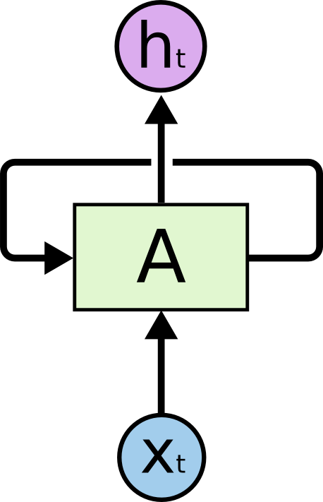
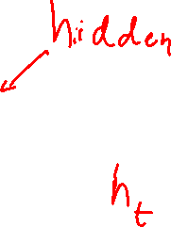
Recurrent Neural Network
Take the output vector and copy it to the input
The input to the recurrent neuron is (x₀, x₁, …, x_{k}, h₀, h₁, …, h_{l})
Otherwise, proceed as normally
Except for back propagation through time
Do not output the state until the end of the input sequence
(sequence-to-vector)

Slide 7
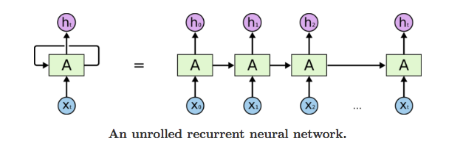
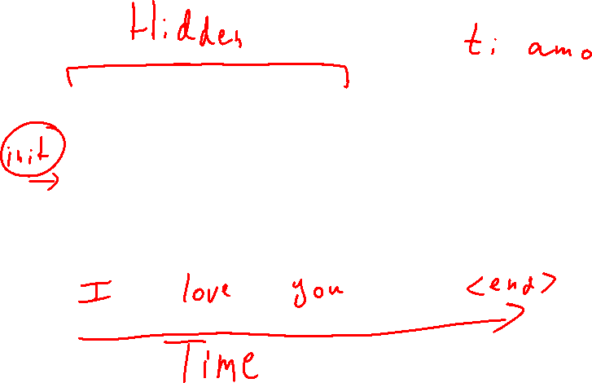
Unrolling recurrent neural networks

Slide 8
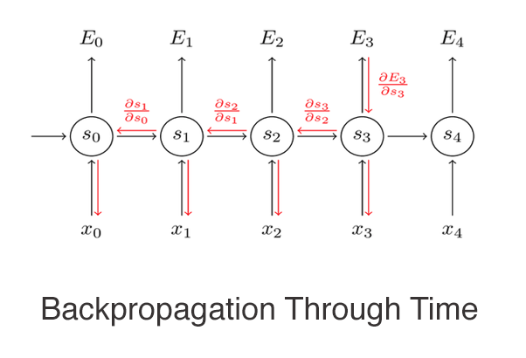
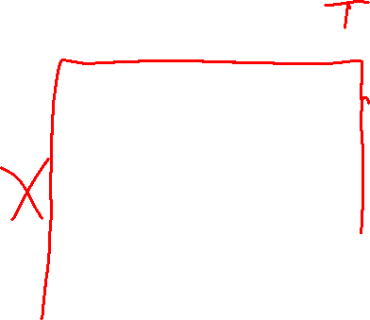
Back propagation through time

Slide 9
Example
disaster tweet.ipynb

Slide 10
Problems with RNNs
Because of the loop-back, RNNs can become unstable
Exploding gradients
Vanishing gradients
LayerNormalization
Default activation function: tanh
Or sigmoid if you need a probability
Short-term memory
The hidden state gets diluted over time
Cannot remember very long back

Slide 11
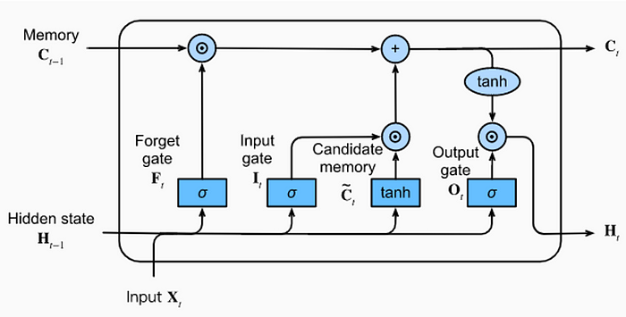
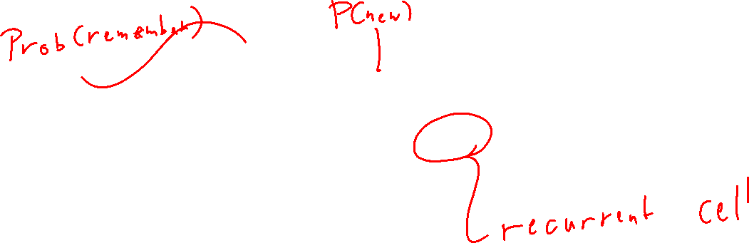
Long Short-Term Memory (LSTM)

Slide 12
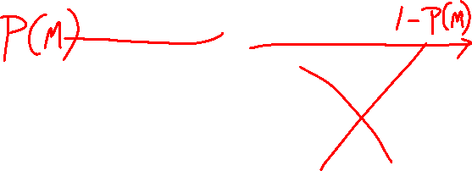
LSTM simplification

Slide 13
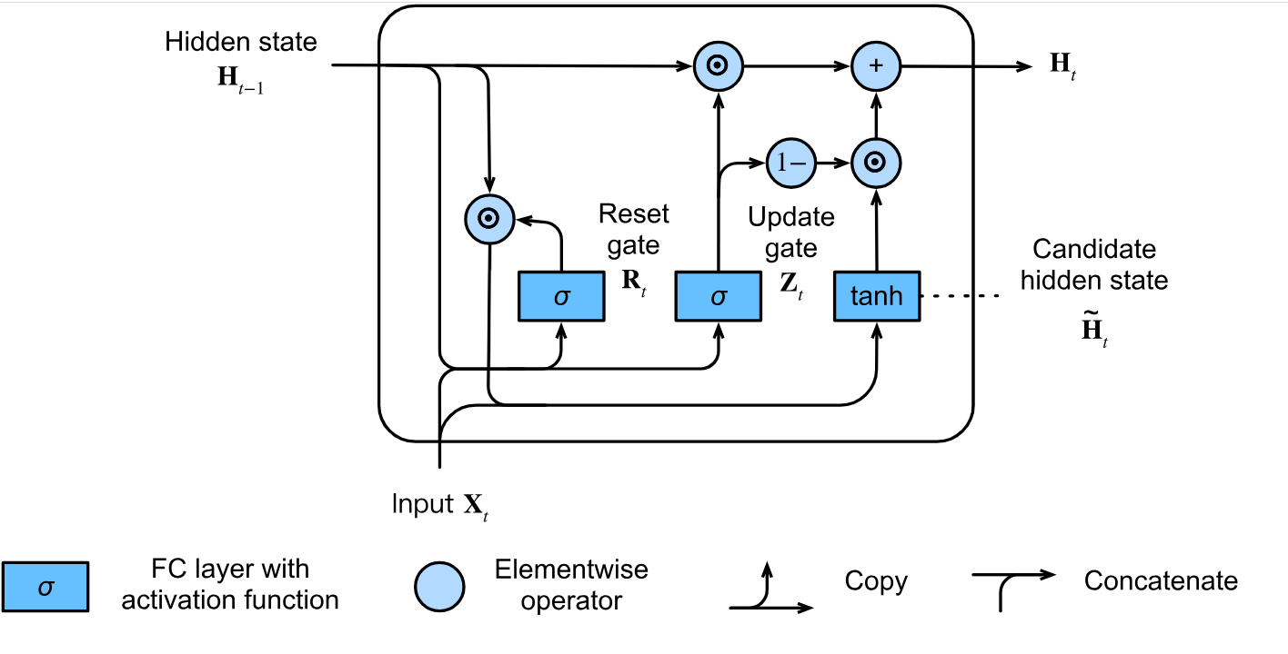
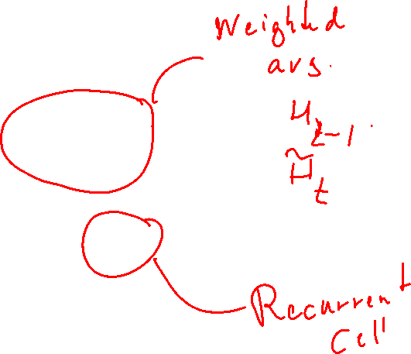
Gated Recurrent Unit (GRU)

Slide 14
Encoder-decoder Architecture
So far, the recurrent networks have been sequence-to-vector
A translation problem is sequence-to-sequence
Wrong idea: Use the ongoing output of the recurrent node
Doesn't solve the "I love you" -> "te amo" problem
Encoder-decoder has 2 recurrent networks:
Encoder:
The encoder is sequence-to-vector
Decoder:
The decoder is vector-to-sequence
It is a generative network

Slide 15
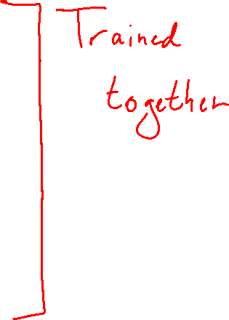
Encoder-decoder Architecture
Encoder:
Receives the words in the sentence one at a time
After the last word outputs its hidden state
(like normal RNN)
Decoder:
Receives the hidden state of encoder as the first hidden state
Gets a special non-word token as its first input
Outputs a word after each input
After that
When predicting: Gets the previous output next input
When training: Gets the expected output as next input

Slide 16
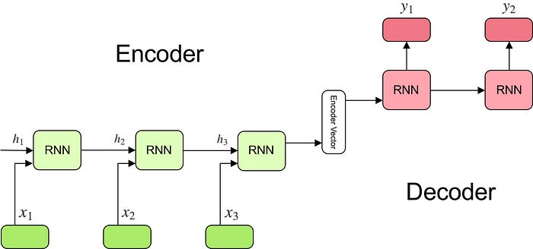
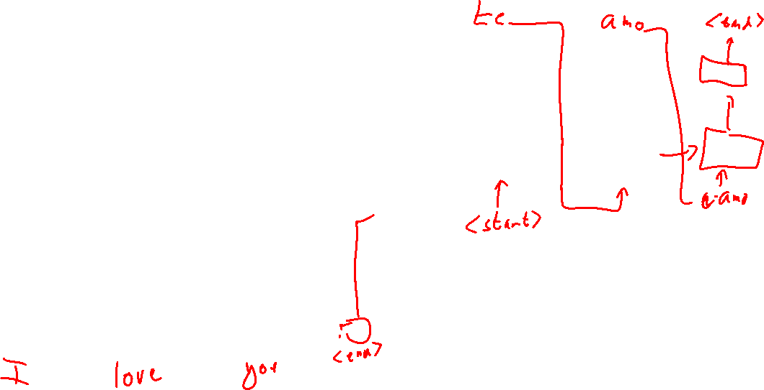
Encoder-decoder

Slide 17
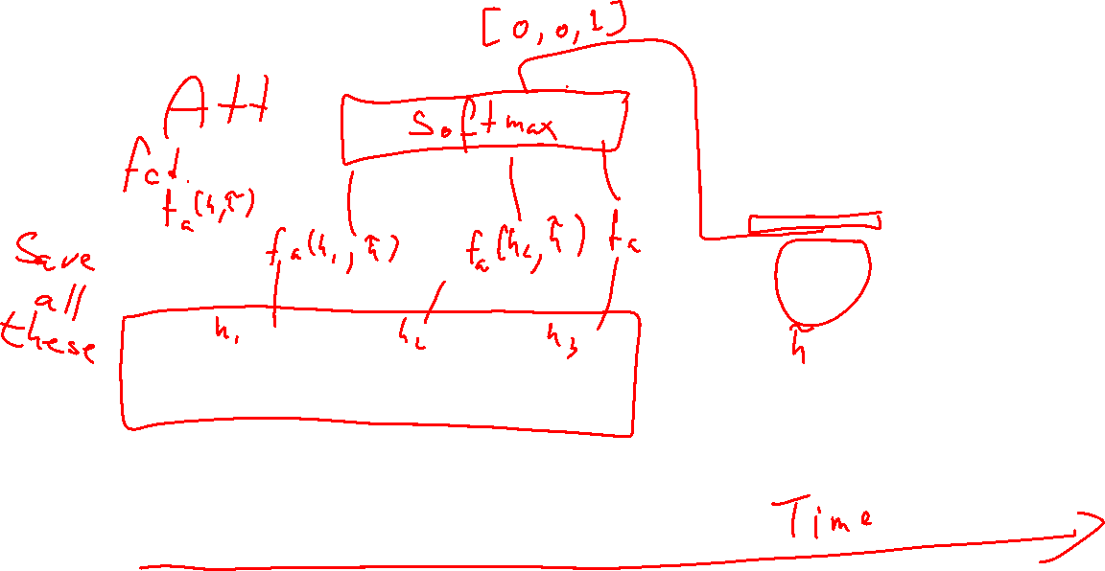
Attention

Slide 18
Autoencoding
Autoencoding is an unsupervised or (self-supervised) learning technique
Goal: To reproduce the input
This is a regression problem
Purpose:
To fix errors in an image
Next word/sentence prediction
To pre-train parts of a network
Independent of network architecture
Convolutional neural networks
Encoder/decoder

Slide 19
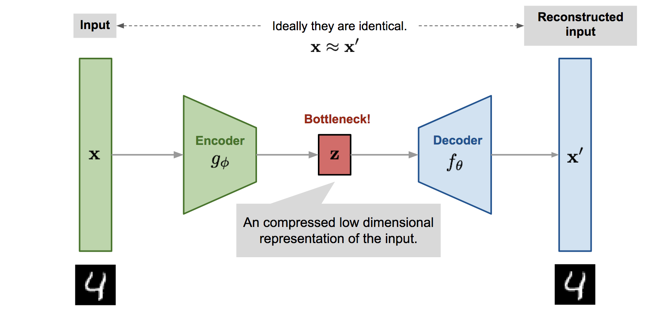
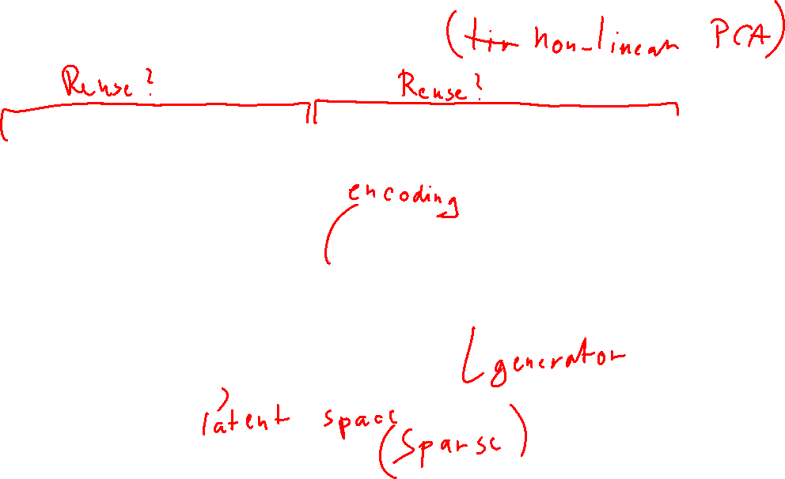
Autoencoder architecture

Slide 20
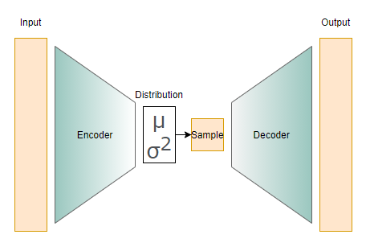
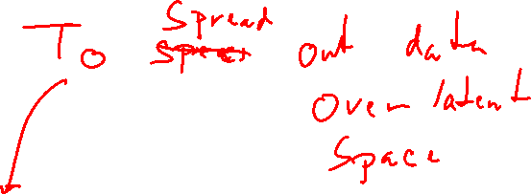
Variational autoencoder (VAE)

Slide 21
Generational Adversarial Networks (GAN)
Consider the Turing test
Human discriminator
Discriminates between
Real output (from another human)
Fake output from a Generator
Generational Adversarial Networks:
Replace the human discriminator with a fake NN
Start with a trained generator (maybe from VAE)
Alternate between training discriminator and generator

Slide 22
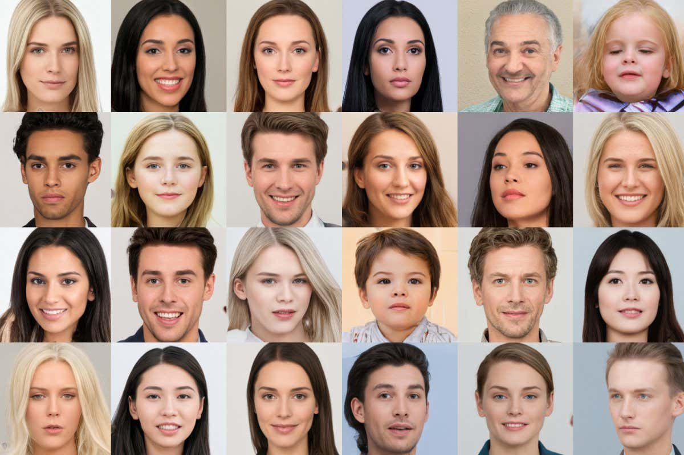
GAN (II)
Used in Midjourney, DALL-E, etc.
Require a lot of time and resources
Generally difficult to manage
Train the discriminator too well: The generator may not be able to catch up
Train the generator too well: It might output only the best image every time
In general, we are trying to reach an unstable equilibrium

Slide 23
Example (autoencoder)
jellyfish-autoencoding.ipynb

